Slide 1

Patient S15_83_RR
DOB: 12/04/1991
Handedness: R
Gender: M
Epilepsy: left temporal oligodendroglioma
Hemisphere: Left
Coverage: Parietal, Temporal
Electrodes: Subdural
Implantation: 2/12/25
Explantation: 2/18/15
Surgeon: Griff Harsh
Prior Surgery: Biopsy from left lateral temporal
Resection: Left lateral temporal lobe around 42 and 43

Slide 2
Neuropsych Information
IQ:
Full-4 IQ = 100
VIQ = 100
PIQ = 100

Slide 3
Recording Information
Neural signal sampling rate 1525.88 Hz
Photodiode sampling rate 24,414 Hz
High pass filter 0.3Hz
Low pass filter 300Hz
iEEG .mat files correspond to ECoG data per channel
Four pdio files correspond to mic (#1), photodiode (#2), and speakers (#3 , #4).
The second pdio file is for the photodiode (Pdio-subjname-02.mat).

Slide 4
Channel Numbers
Clinical Label | ECoG Channes
OC 1-32 | 1-32
ST 1-24 | 33-56
TP 6-10 | 57-61
EMPTY | 62-64
LG 1-64 | 65-128

Slide 5
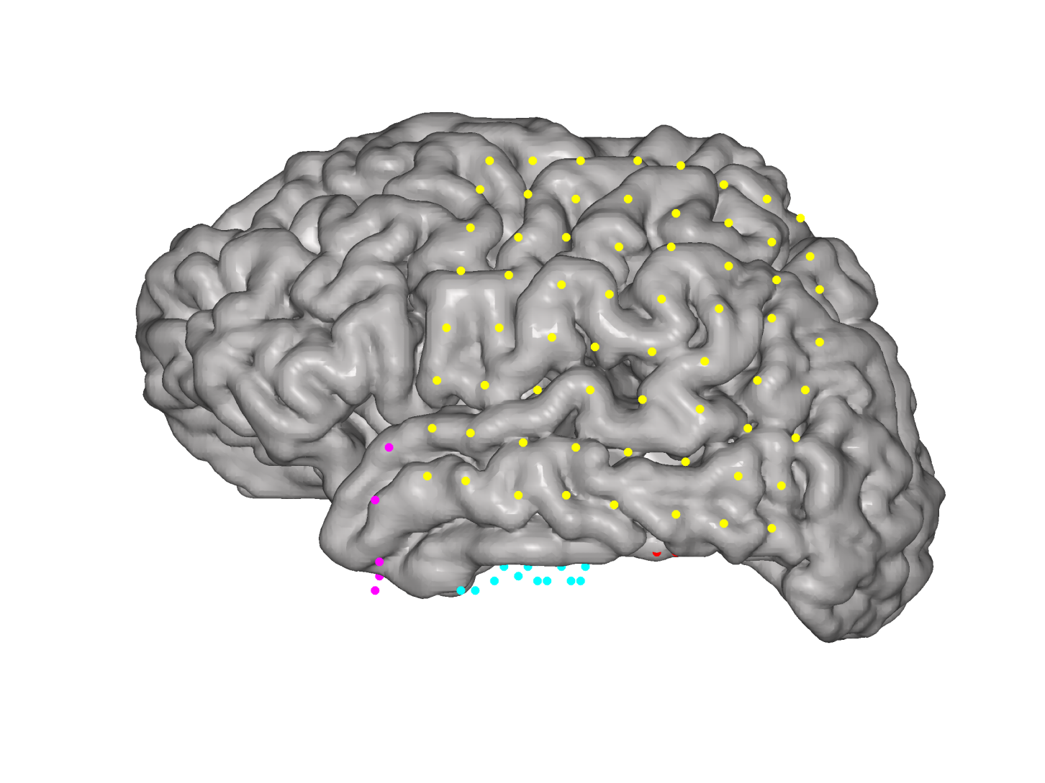
Lateral View

Slide 6
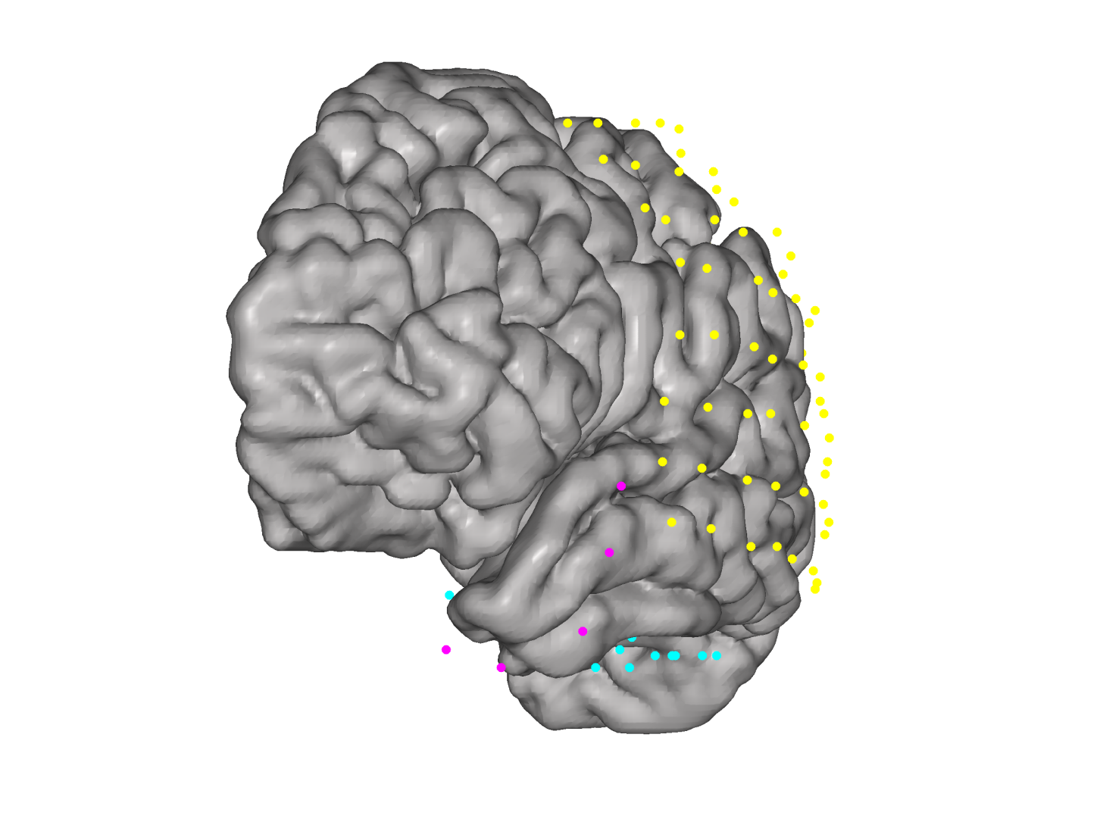
Anterio Lateral View

Slide 7
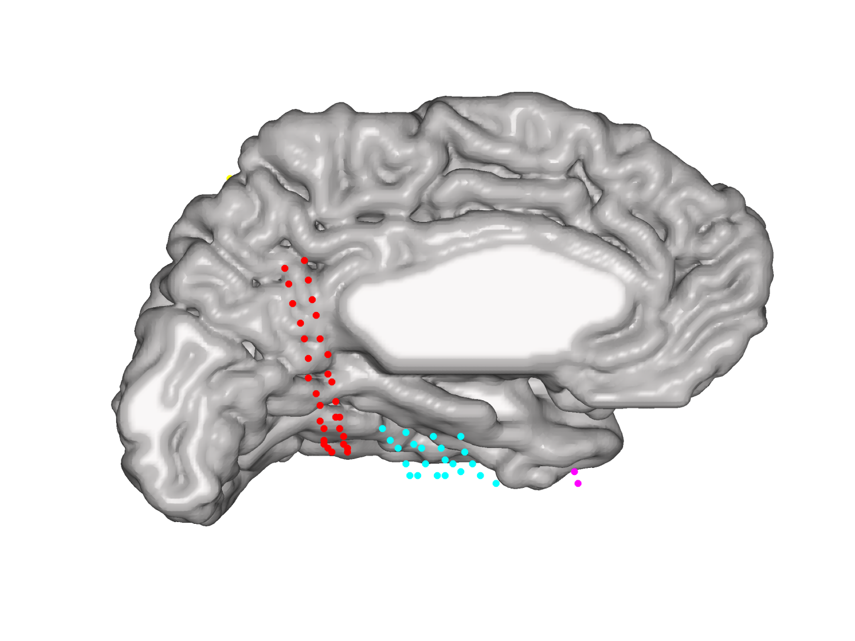
Mesial View

Slide 8
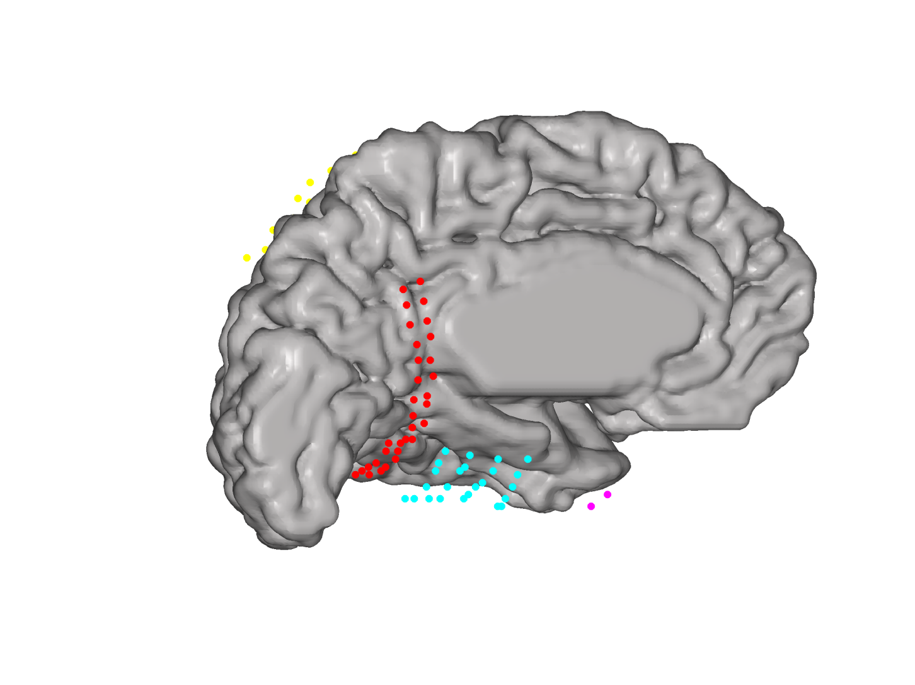
Mesial View

Slide 9
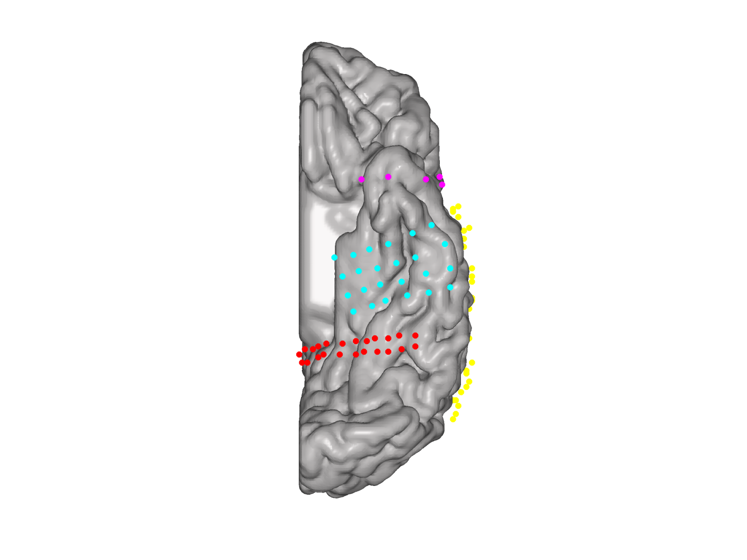
Ventral View

Slide 10
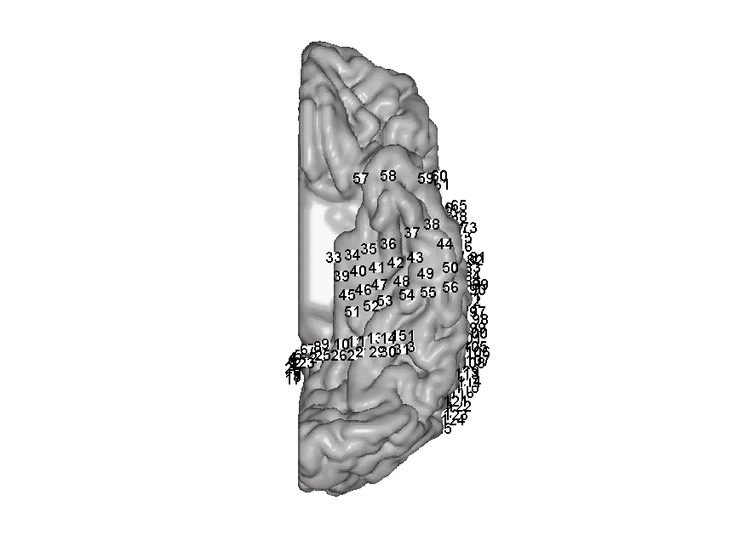
Ventral View

Slide 11
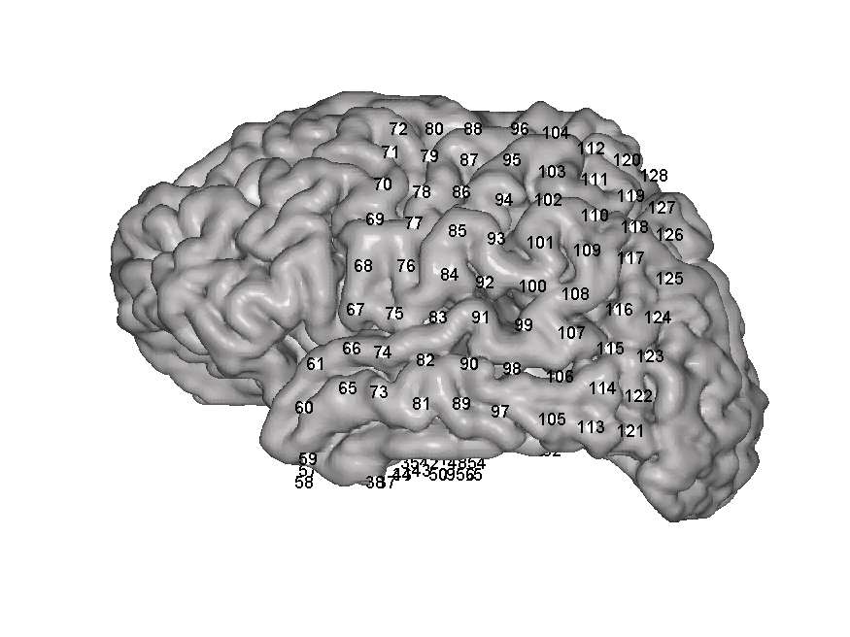
Lateral View

Slide 12
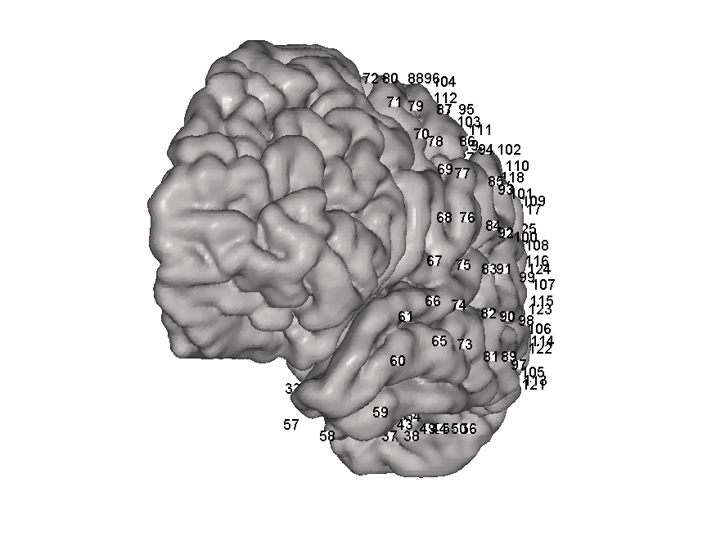
Anterio – lateral View

Slide 13
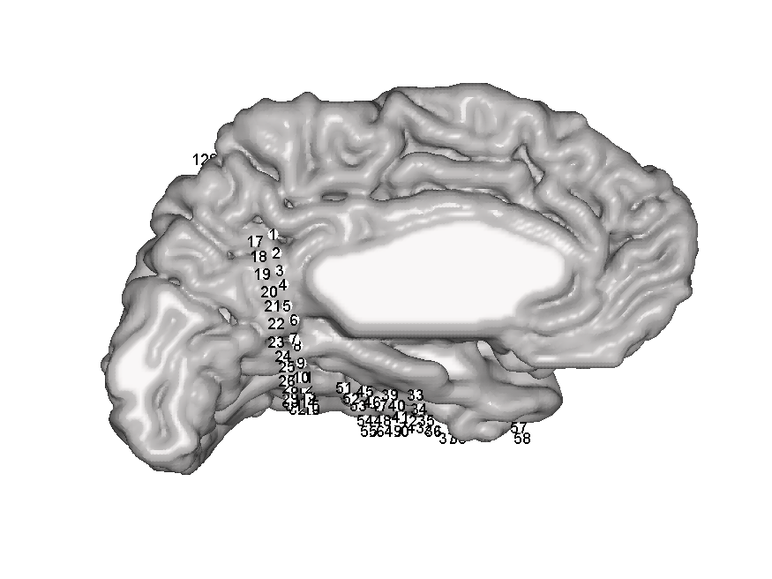
Mesial View

Slide 14
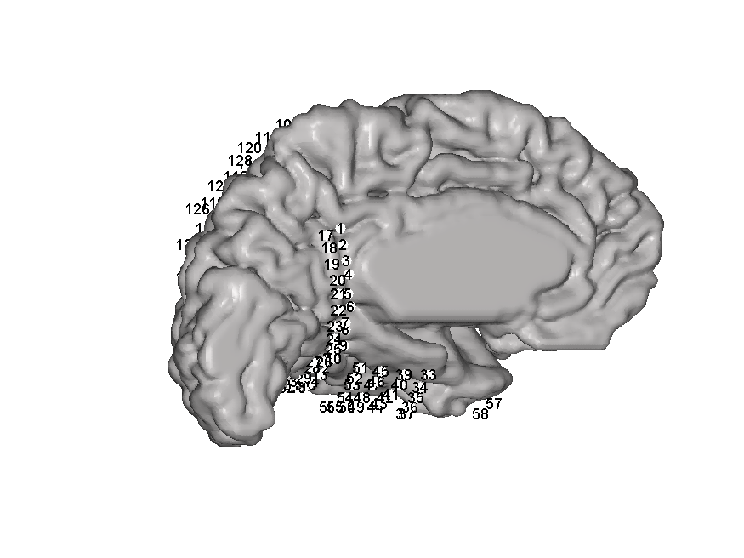
Mesial View

Slide 15
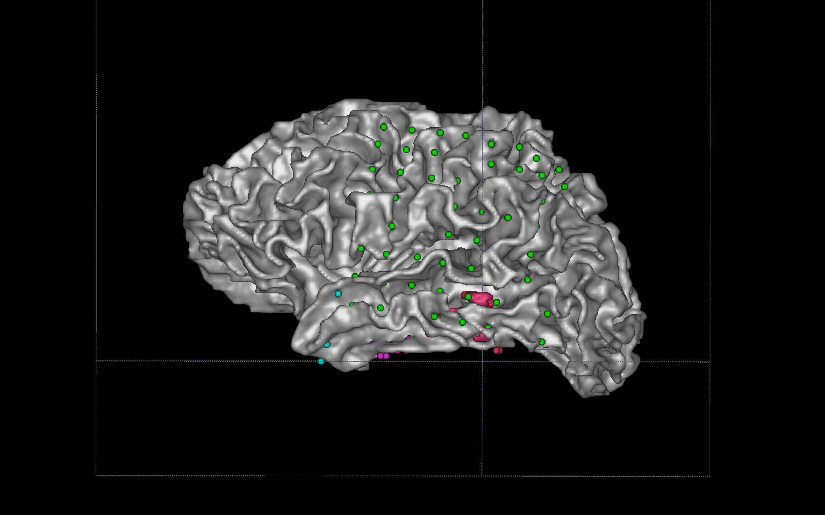
Lateral View White Matter
LG 8
LG 16
LG 24
LG 32
LG 40
LG 56
LG 48
LG 64
LG 1
LG 9
LG 17
LG 25
LG 33
LG 49
LG 41
LG 57

Slide 16
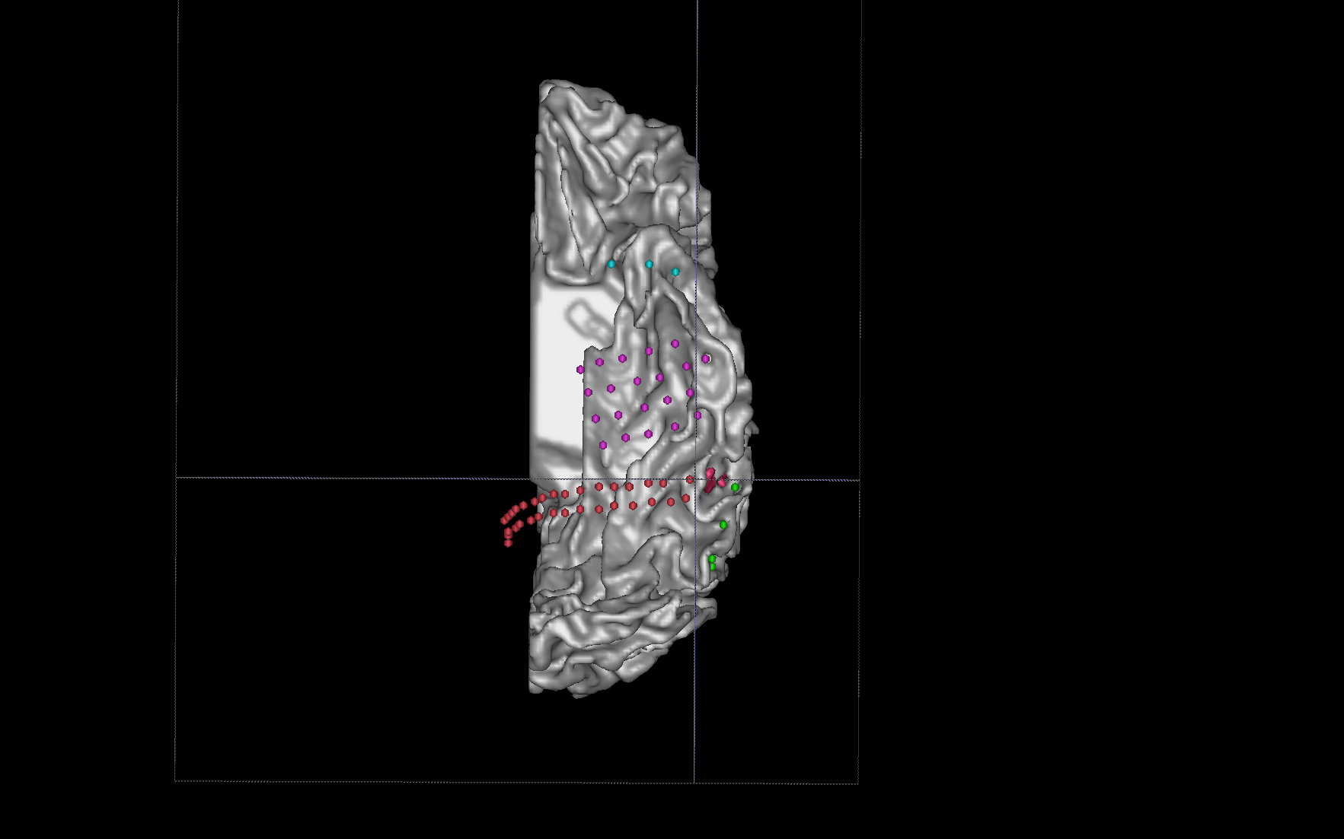
Ventral View White Matter
TP 6 - 10
ST 6
ST 1
ST 12
ST 7
ST 18
ST 13
ST 24
ST 19
OC 16
OC 32

Slide 17
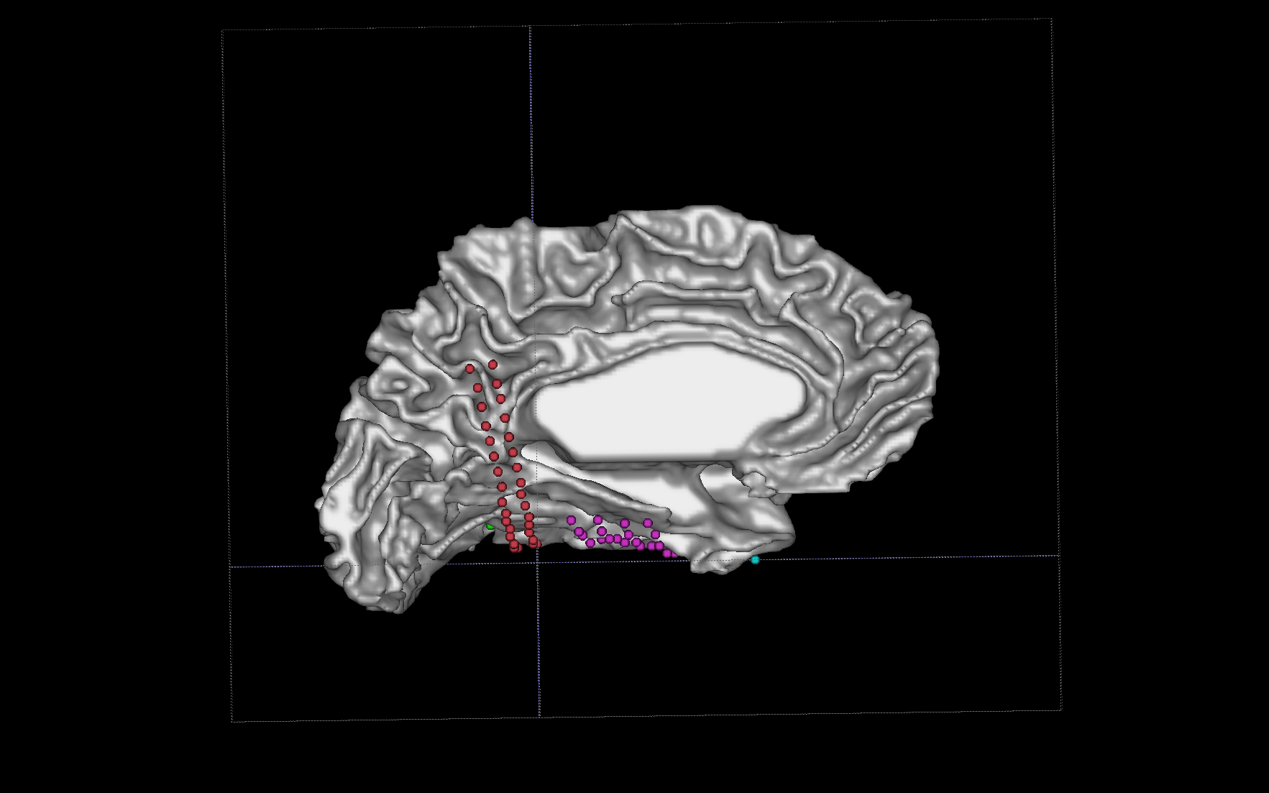
Mesial View White Matter
OC 17
OC 1

Slide 18
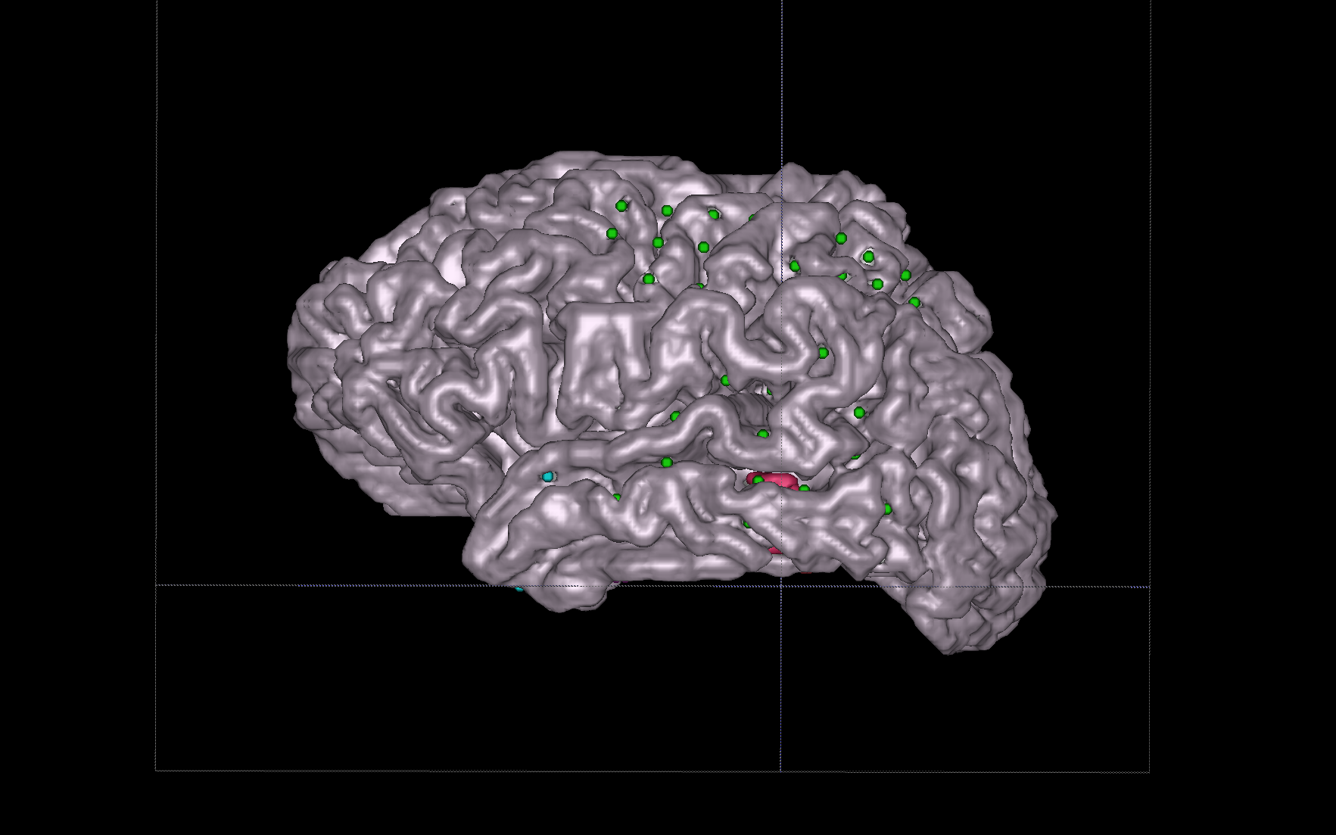
Lateral View Gray Matter

Slide 19
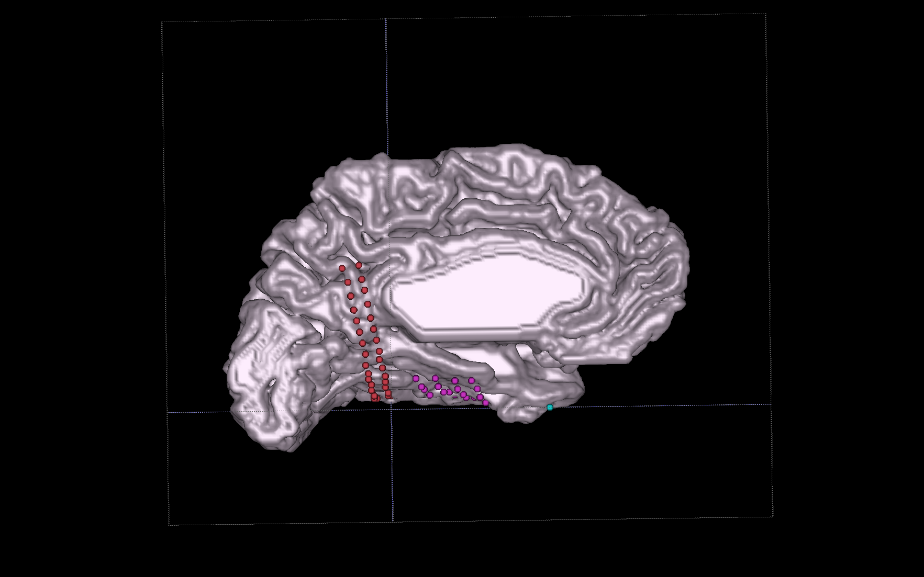
Mesial View Gray Matter

Slide 20
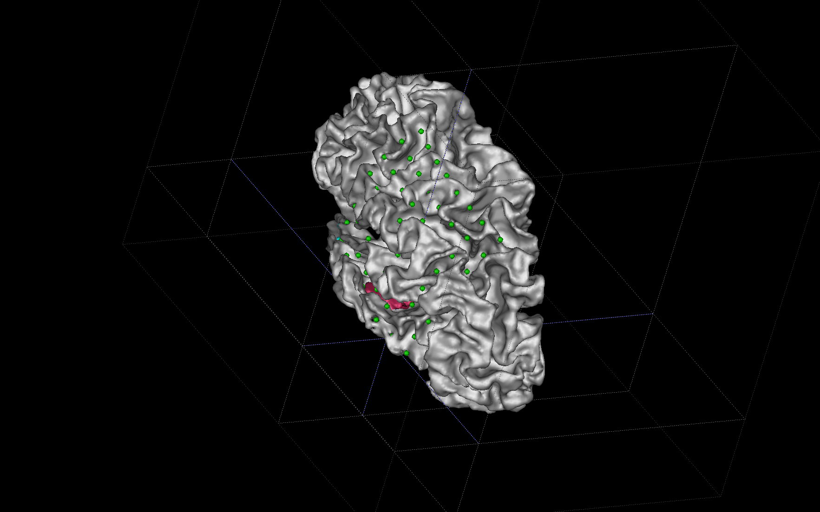
Posterior View White Matter

Slide 21
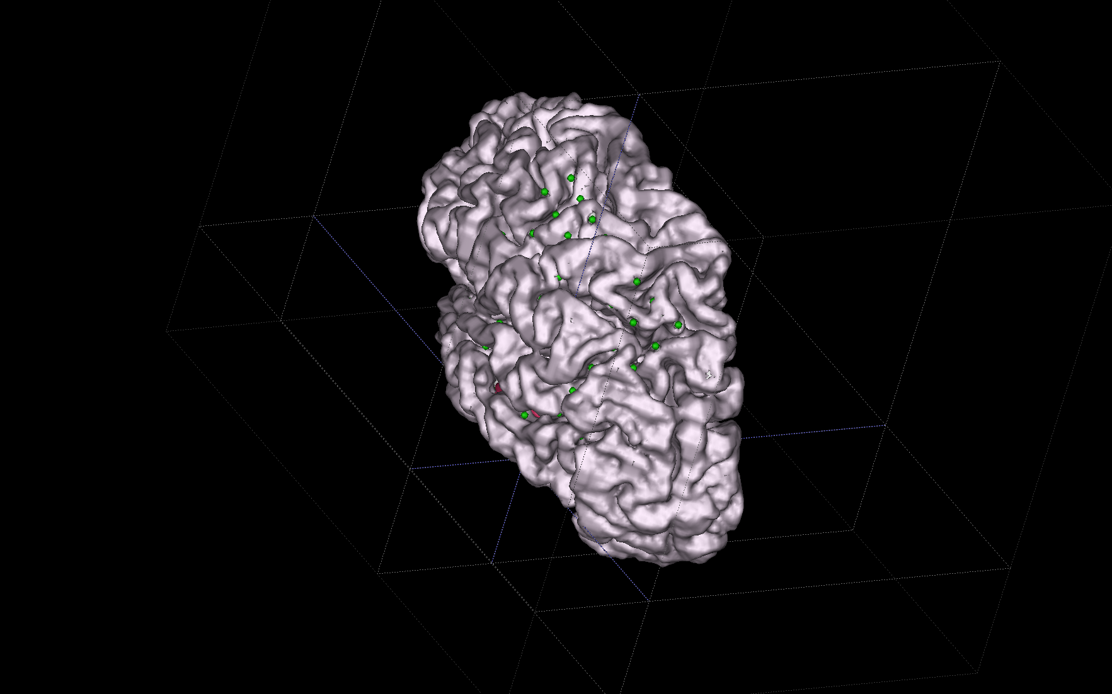
Posterior View Gray Matter

Slide 22
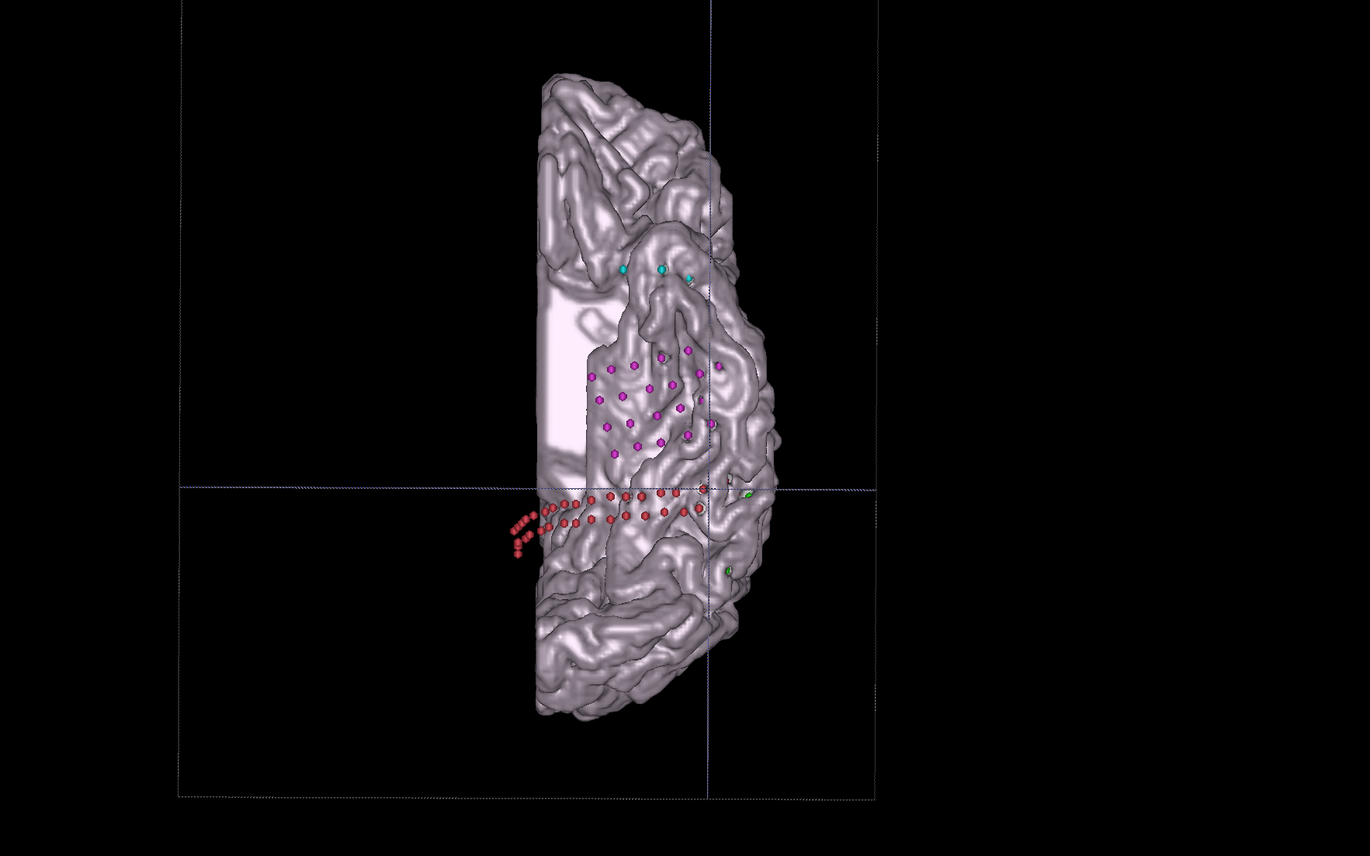
Ventral View Gray Matter

Slide 23
Channel Information
Pathological Channels:
Seizure source : LG 42 and 43
Spikes: most often at OC4-6, 20-22, TP 6-10, ST1-2, 13-14, 19-21, and less often at LG 5, 9, 18, 20, 42-43, 61-63.
A prominent and frequently encountered discharge is a broad field polyspike, seen earliest across TP 6-10, ST 1-3, ST 7-8 (less prominent), ST 13-14, ST 19-21, followed within ~50 msec by a spike across LG1-2, LG 5-6, LG 18-19, with the discharge becoming less well-formed as it moves more posteriorly across the lateral grid within milliseconds
Noisy Channels: 33, 42, 45, 47, 48, 57, 85
Empty Channels: 62-64
Reference Channels: LG 18, ECoG 82

Slide 24
Tasks Run
Block Name | Task Name
S15_88_RR_01 | Natural Conv
S15_88_RR_03 | MMR 1
S15_88_RR_04 | Rest EC
S15_88_RR_05 | 7-heaven
S15_88_RR_06 | Rest EC 7min
S15_88_RR_08 | MMR 2
S15_88_RR_09 | Classroom Passive
S15_88_RR_12 | Calculia_Passive 5
S15_88_RR_14 | Calculia_Passive 6
S15_88_RR_16 | Calculia_Passive 7
S15_88_RR_17 | Calculia_Passive 8
S15_88_RR_18 | Calculia_Active_1
S15_88_RR_19 | Rest EC
Block Name | Task Name
S15_88_RR_20 | Calculia_Active_2
S15_88_RR_23 | Calc_Active 3
S15_88_RR_24 | Calc_Active 4
S15_88_RR_25 | VTC loc
S15_88_RR_26 | Scrambled
S15_88_RR_27 | Classroom baseline
S15_88_RR_28 | Rest-5min
S15_88_RR_31 | Schacter
S15_88_RR_32 | Classroom Categ Interact 1
S15_88_RR_33 | Classroom Categ Interact 2
S15_88_RR_34 | Classroom Categ Interact 3
S15_88_RR_35 | Classroom Categ Interact 4
S15_88_RR_36 | Classroom Categ Interact 5

Slide 25
Tasks Run
Block Name | Task Name
S15_88_RR_37 | Classroom Categ Interact 6
S15_88_RR_38 | Classroom Categ Interact 7
S15_88_RR_39 | Classroom Categ Interact 8
S15_88_RR_40 | Classroom Categ Interact 9
S15_88_RR_43 | Classroom Categ Interact 10
S15_88_RR_44 | Classroom Categ Interact 11
S15_88_RR_46 | Animal Loc
S15_88_RR_47 | Alex 1 (SS2)
S15_88_RR_48 | Alex 2 (SS2)
S15_88_RR_49 | Alex 3 (SS2)
S15_88_RR_50 | Alex 4 (SS2)
S15_88_RR_51 | Alex 5 (SS2)
S15_88_RR_52 | Alec 6 (SS2)
Block Name | Task Name
S15_88_RR_53 | Alec 7 (SS2)
S15_88_RR_54 | Alex 8 (SS2)
S15_88_RR_55 | Alex 9 (SS2)
S15_88_RR_56 | Alex 10 (SS2)
S15_88_RR_57 | Classroom Categ Learn
S15_88_RR_58 | Classroom – Post Categ learning
S15_88_RR_59 | Alternate (Gallant)
S15_88_RR_60 | From boyhood (Gallant)
S15_88_RR_63 | Cat Det 2
S15_88_RR_64 | Cat Det 3
S15_88_RR_65 | Cat Det 4
S15_88_RR_66 | Cat Det 5
S15_88_RR_67 | Cat Det 6

Slide 26
Tasks Run
Block Name | Task Name
S15_88_RR_68 | Cat Det 7
S15_88_RR_69 | Localizer 1 (Kastner)
S15_88_RR_70 | Localizer 2 (Kastner)
S15_88_RR_71 | Localizer 3 (Kastner)
S15_88_RR_72 | Localizer 4 (Kastner)
S15_88_RR_73 | Localizer 5
 | Scene questions
S15_88_RR_74 | Trans Int 1
S15_88_RR_75 | Trans Int 2
S15_88_RR_76 | Trans Int 3
S15_88_RR_77 | Trans Int 4
S15_88_RR_78 | Trans Int 5
S15_88_RR_88 | Rest EC 5min
Block Name | Task Name
S15_88_RR_89 | My Friendly.. (Gallant 3)
S15_88_RR_91 | Naked (Gallant 4)
S15_88_RR_92 | ER 1
S15_88_RR_93 | Recall 1
S15_88_RR_94 | ER 2
S15_88_RR_95 | Recall 2
S15_88_RR_96 | ER 3
S15_88_RR_97 | Recall 3
S15_88_RR_98 | Trans Learning 6
S15_88_RR_99 | Rest EC 5 min
S15_88_RR_100 | Classroom Baseline
S15_88_RR_102 | Calculia Recording 1
S15_88_RR_103 | Calculia Recording 2

Slide 27
Tasks Run
Block Name | Task Name
S15_88_RR_104 | Calculia _Act 3
S15_88_RR_105 | Alex (SS2)
S15_88_RR_106 | Alex (SS2)
S15_88_RR_107 | Alex (SS2)
S15_88_RR_108 | Alex (SS2)
S15_88_RR_109 | Landmark Study 1
S15_88_RR_110 | Landmark Test 1
S15_88_RR_111 | Landmark Study 2
S15_88_RR_112 | Landmark Test 2
S15_88_RR_113 | Landmark Study 3
S15_88_RR_114 | Landmark Test 3
S15_88_RR_115 | Landmark Study 4
S15_88_RR_117 | Landmark Test 4
S15_88_RR_118 | Kanwisher 1
S15_88_RR_119 | Kanwisher 2
S15_88_RR_120 | Kanwisher 3
S15_88_RR_121 | Classroom Passive

Slide 28
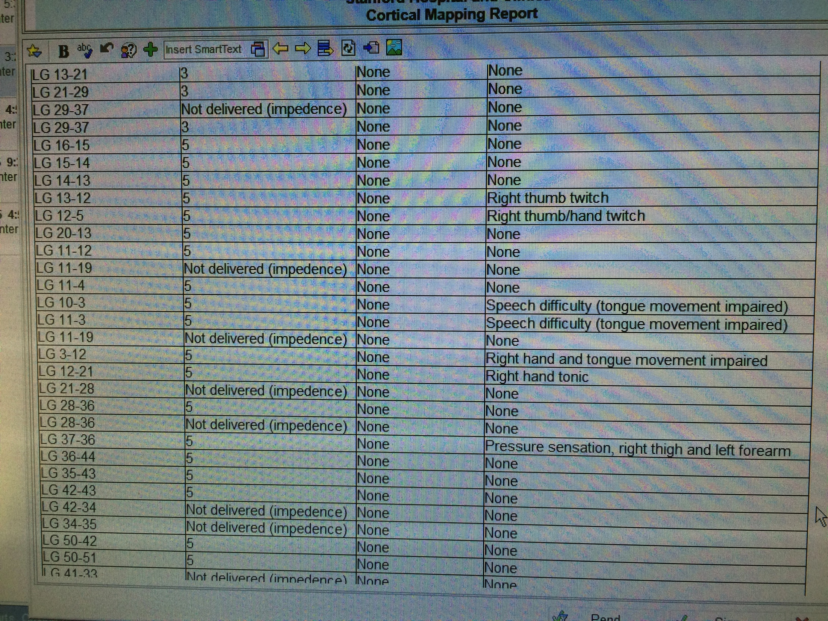
EBS Results

Slide 29
EBS Results
Electrode Contacts | mAmps | After-discharges | Clinical Response
LG 5-6 | 3 | None | None
LG 5-6 | 5 | None | None
LG 6-13 | 3 | None | None
LG 6-13 | 5 | None | None
LG 13-21 | 3 | None | None
LG 21-29 | 3 | None | None
LG 29-37 | Not delivered (impedence) | None | None
LG 29-37 | 3 | None | None
LG 16-15 | 5 | None | None
LG 15-14 | 5 | None | None
LG 14-13 | 5 | None | None
LG 13-12 | 5 | None | Right thumb twitch
LG 12-5 | 5 | None | Right thumb/hand twitch
LG 20-13 | 5 | None | None
LG 11-12 | 5 | None | None
LG 11-19 | Not delivered (impedence) | None | None
LG 11-4 | 5 | None | None
LG 10-3 | 5 | None | Speech difficulty (tongue movement impaired)
LG 11-3 | 5 | None | Speech difficulty (tongue movement impaired)
LG 11-19 | Not delivered (impedence) | None | None
LG 3-12 | 5 | None | Right hand and tongue movement impaired
LG 12-21 | 5 | None | Right hand tonic
LG 21-28 | Not delivered (impedence) | None | None
LG 28-36 | 5 | None | None
LG 28-36 | Not delivered (impedence) | None | None
LG 37-36 | 5 | None | Pressure sensation, right thigh and left forearm
LG 36-44 | 5 | None | None
LG 35-43 | 5 | None | None

Slide 30
EBS Results
Electrode Contacts | mAmps | After-discharges | Clinical Response
LG 42-43 | 5 | None | None
LG 42-34 | Not delivered (impedence) | None | None
LG 34-35 | Not delivered (impedence) | None | None
LG 50-42 | 5 | None | None
LG 50-51 | 5 | None | None
LG 41-33 | Not delivered (impedence) | None | None
LG 41-49 | 5 | None | None
LG 41-49 | 7 | None | None
LG 49-57 | 5 | None | None
LG 49-57 | 7 | None | None
LG 33-25 | Not delivered (impedence) | None | None
LG 25-17 | Not delivered (impedence) | None | None
LG 17-9 | Not delivered (impedence) | None | None
OC 1-17 | 7 | None | None
OC 2-18 | 7 | None | None
OC 3-19 | 7 | None | None
OC 4-20 | 7 | None | None
OC 21-22 | 7 | None | None
OC 22-23 | 7 | None | None
OC 23-24 | 7 | None | None
OC 24-25 | 7 | None | None
OC 25-26 | 7 | None | None
OC 26-27 | 7 | None | None
OC 27-28 | 7 | None | None
OC 28-29 | 7 | None | None
OC 29-30 | 7 | None | None
OC 30-31 | 7 | None | None
OC 31-32 | 7 | None | None
OC 16-15 | 7 | None | None

Slide 31
EBS Results
Electrode Contacts | mAmps | After-discharges | Clinical Response
OC 15-14 | 7 | None | None
OC 14-13 | 7 | None | None
OC 13-12 | 7 | None | None
OC 12-11 | 7 | None | None
OC 11-10 | 7 | None | None
OC 10-9 | 7 | None | None
OC 9-8 | 7 | None | None
OC 8-7 | 7 | None | None
OC 12-28 | 10 | None | None (able to read during stimulus)
OC 12-28 | 10 | None | None

Slide 32
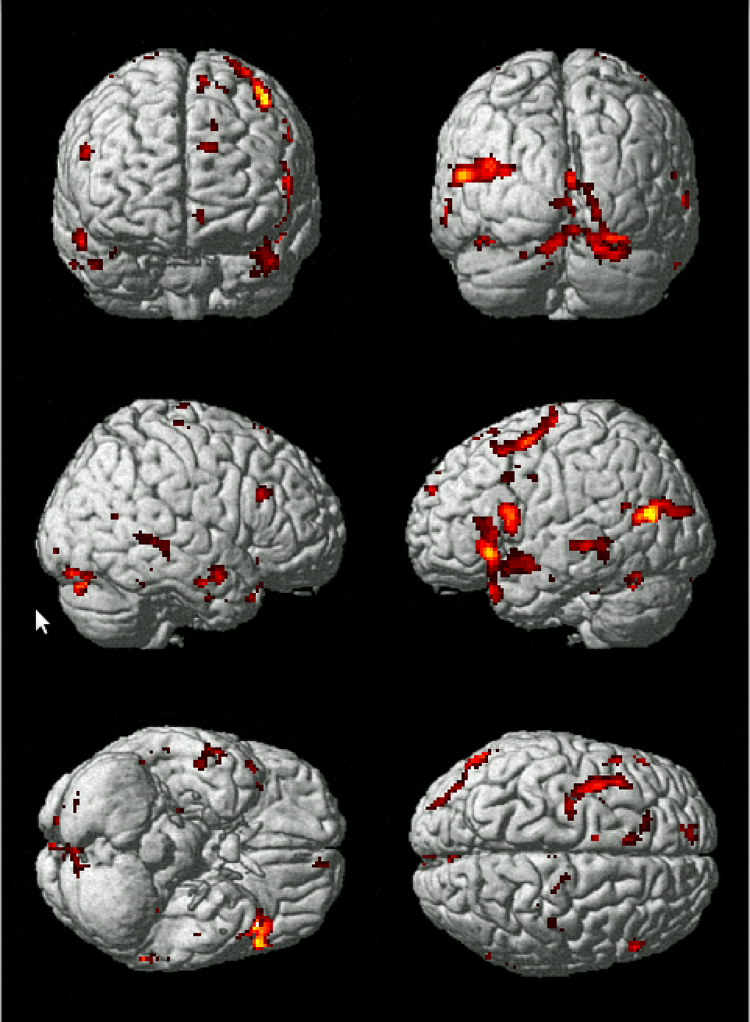
Language Heat-Map

Slide 33
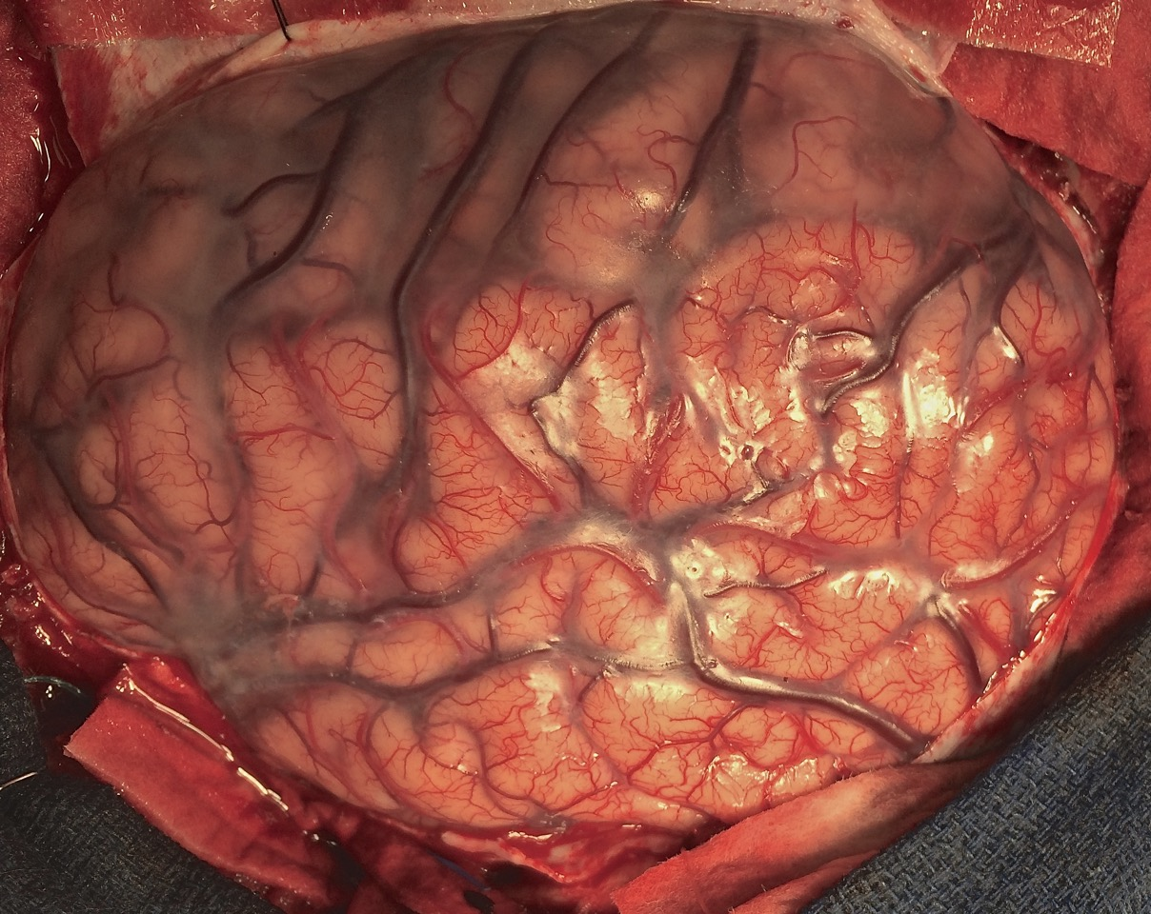
Operative Photos

Slide 34
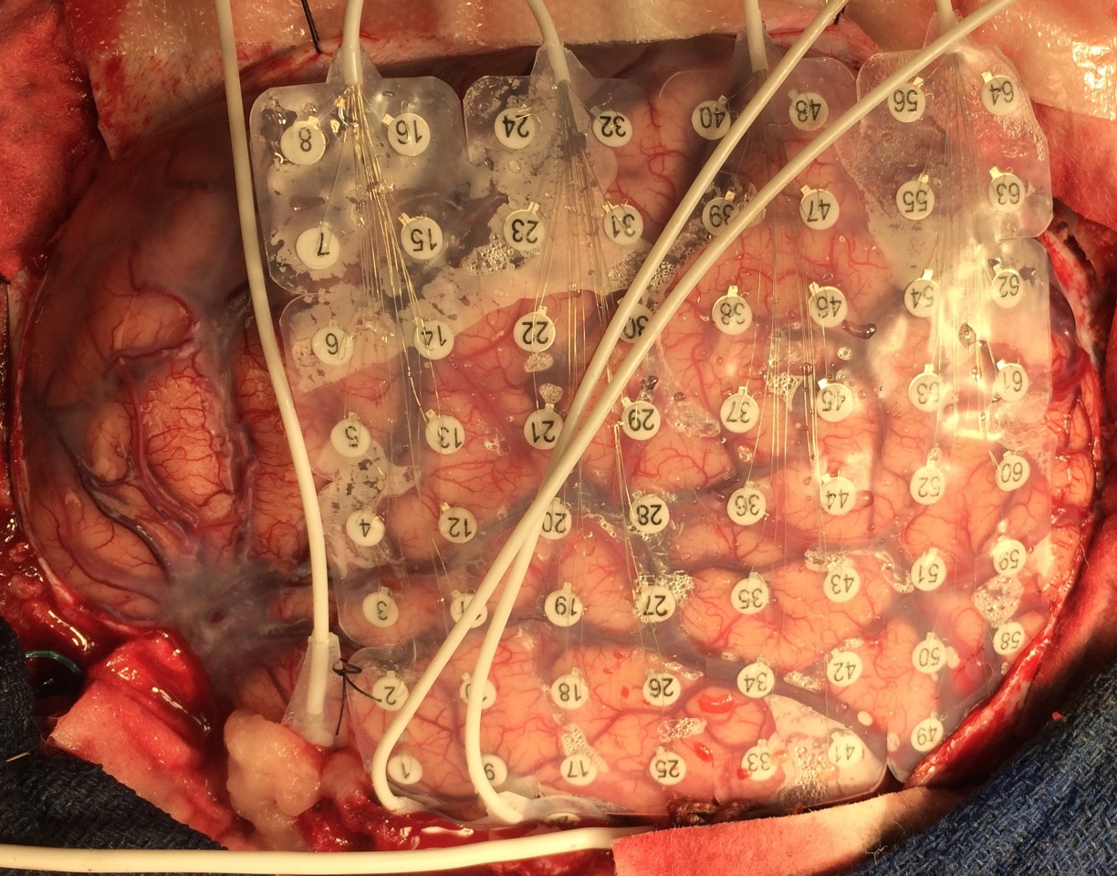
Operative Photos Post-implantation pre-closure

Slide 35
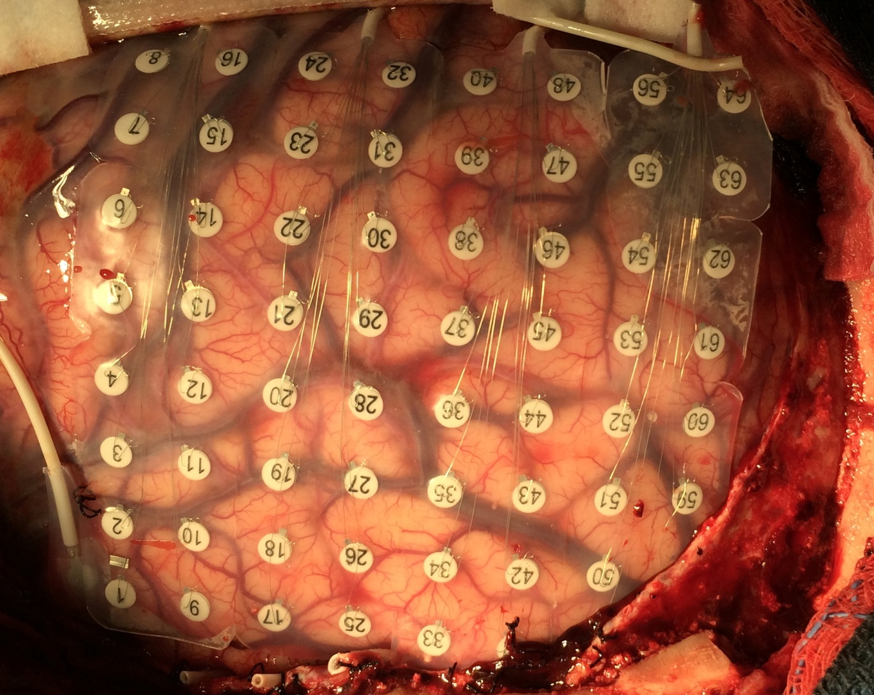
Operative Photos Post-implantation pre-resection
Significant shift
e.g., 43-42
and the vein

